Slide 1
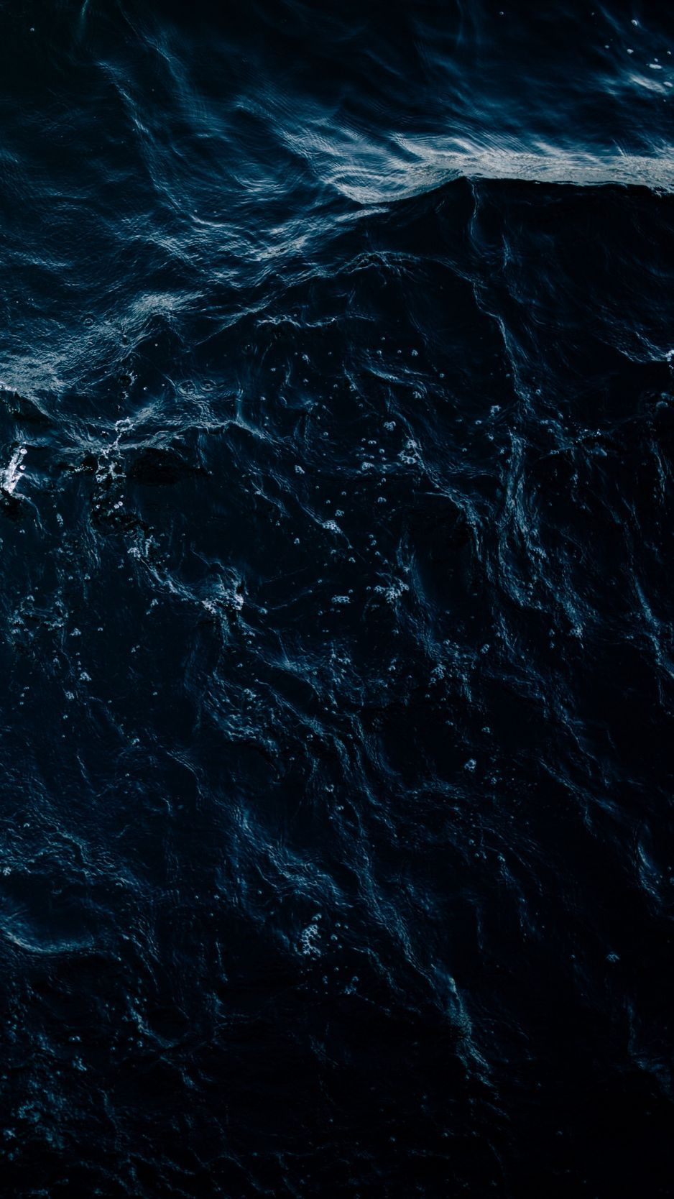
THE EFFECT OF HIGH PRESSURE ENVIRONMENT ON ANIMALS
GROUP 25

Slide 2
OUTLINE
Introduction
Characteristics of deep sea environments
Examples of organisms living in high pressure environment
Effects of high pressure environment on animals
Adaptations adopted by some organisms living in the deep sea
Conclusion

Slide 3
INTRODUCTION
Is an environment where the pressure is significantly higher than the atmospheric pressure at sea level.
This occurs in various settings e.g. deep sea environments, hydrothermal vents and underground oil reserves

Slide 4
CHARACTERISTICS OF DEEP SEA ENVIRONMENTS.
Deep sea environments are mainly characterized by;
High pressure
High salinity
Low temperature
Low oxygen
Absence of light

Slide 5
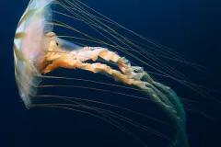
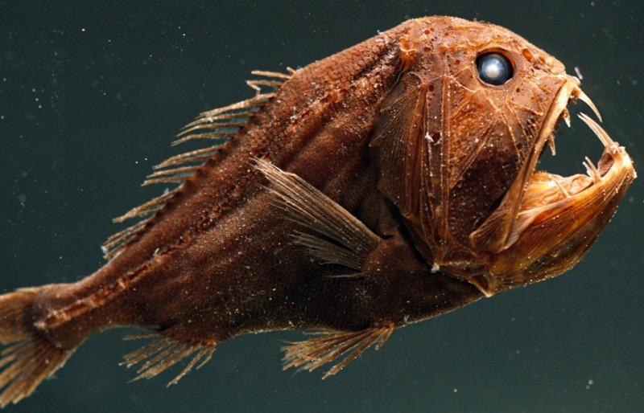
EXAMPLES OF ORGANISMS LIVING IN HIGH PRESSURE ENVIRONMENT
Deep sea invertebrates
E.g. Jellyfish and tomoptera
Deep sea fishes
E.g. fangtooth Fish
Fig. A
Fig. A
Fig. A
Fig. A
Fig. B

Slide 6
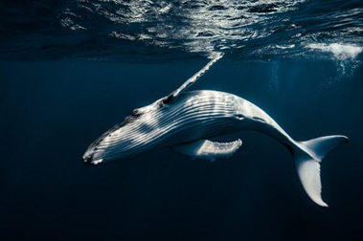
CONT’D
. Marine mammals
E.g. Whales and seals
Fig. CFig. A

Slide 7
EFFECTS OF HIGH PRESSURE ENVIRONMENT ON ANIMALS.
Reduced oxygen availability
Change in metabolism
Behavioral adaptations
Physical adaptations
Limited food availability

Slide 8
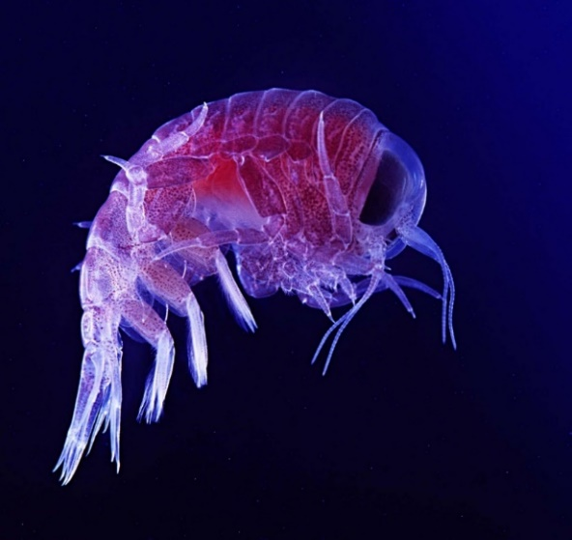
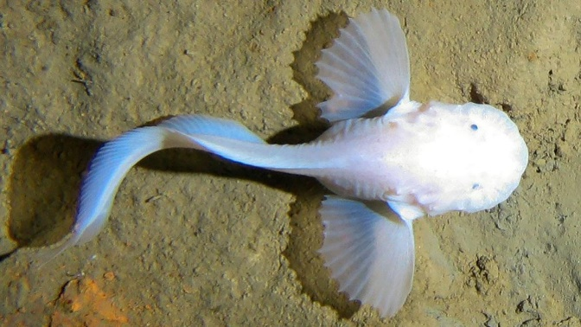
ADAPTATIONS ADOPTED BY SOME ORGANISMS LIVING IN THE DEEP SEA
Presence of Trimethylamine Oxide (TMAO).
High concentrations of organic molecules (piezolytes) stops their cellular membranes and proteins from being crushed.
E.g Giant amphipod crustaceans and Mariana snailfish.
Fig. DFig. A
Fig. E

Slide 9
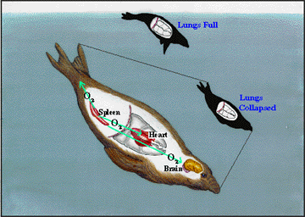
CONT’D
Deflation of lungs
The lungs will deflate gas into the muscles and bloodstreams. Muscles are adapted to hold myoglobin while in blood possesses more hemoglobin.
Fig. A
Fig. FFig. A

Slide 10
CONT’D
Lowered heart rate.
Some creatures can reduce their heart beat to 4 beats per second and other stop breathing while driving.
Reduced movement.
Lowered metabolic activity.
Shutdown of digestive, liver and kidney functions

Slide 11
CONCLUSION
Overall, high pressure environments present unique challenges for animals and their survival often depends on specialized adaptations to counteract the effects of extreme pressure.

Slide 12
REFERENCES
Gerretsen, I. (2023) How do fish survive in the deep ocean?, BBC Future. Available at: https://www.bbc.com/future/article/20230404-how-do-animals-survive-in-the-deep-ocean# (Accessed: 31 July 2023).
Omondi, S. (2019) How do deep sea creatures survive the high water pressure?, WorldAtlas. Available at: https://www.worldatlas.com/articles/how-do-deep-sea-creatures-survive-the-high-water-pressure.html#:~:text=These%20creatures%20have%20several%20adaptations,in%20their%20deep%2Dwater%20environment. (Accessed: 31 July 2023).
Welch, C. (2021) Oceans are losing oxygen-and becoming more hostile to life, Science. Available at: https://www.nationalgeographic.com/science/article/150313-oceans-marine-life-climate-change-acidification-oxygen-fish#:~:text=Deep%20ocean%20waters%20hold%20far,up%20what%20little%20oxygen%20remains. (Accessed: 01 August 2023).

Slide 13
THANK YOU

